Slide 1
Generation of ECG for Heart Block Cases
Venkatesh Nayak
4NM18EE064
7th sem, EEE NMAMIT

Slide 2
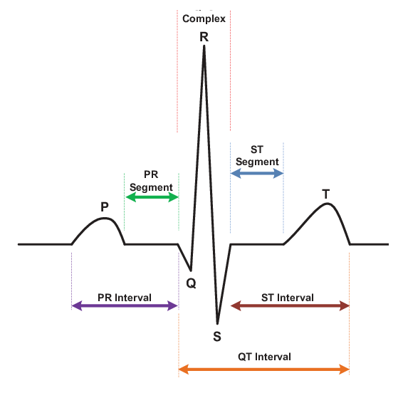
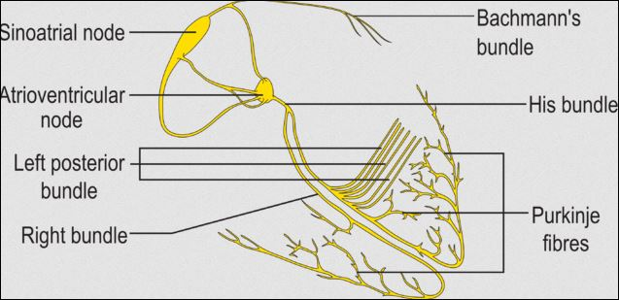
ECG MORPHOLOGY
Isoelectric line or Base line.
ECG consists of P Q R S and T waves.
Initiates with a P wave for short interval.
Accompanied by the QRS complex.
Terminates with the T wave.
Healthy heart beat : 60 – 100 BPM

Slide 3
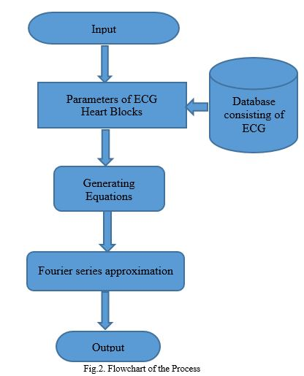
Work flow

Slide 4
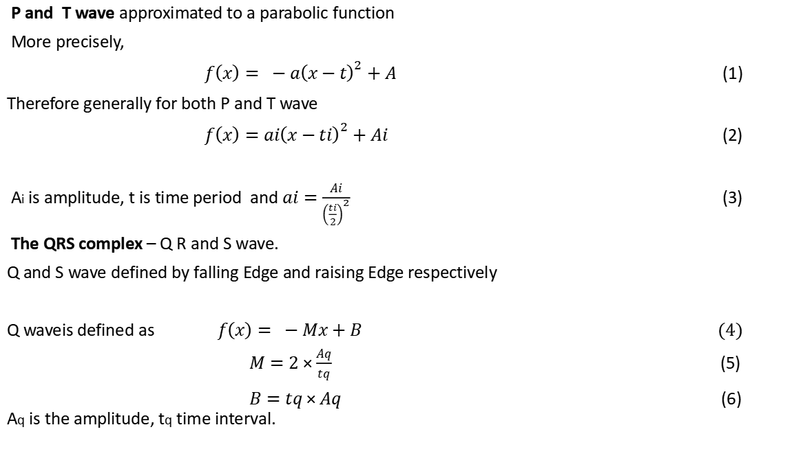
Mathematical Model
P and T wave approximated to a parabolic function
More precisely,
$f\left(x\right)= −a{\left(x−t\right)}^{2}+A$ (1)
Therefore generally for both P and T wave
$f\left(x\right)=a{i\left(x−ti\right)}^{2}+Ai$ (2)
Ai is amplitude, t is time period and $ai=\frac{Ai}{{\left(\frac{ti}{2}\right)}^{2}}$ (3)
The QRS complex – Q R and S wave.
Q and S wave defined by falling Edge and raising Edge respectively
Q waveis defined as $f\left(x\right)= −Mx+B (4)$
$M=2×\frac{Aq}{tq}$ (5)
$B=tq×Aq$ (6) Aq is the amplitude, tq time interval.

Slide 5
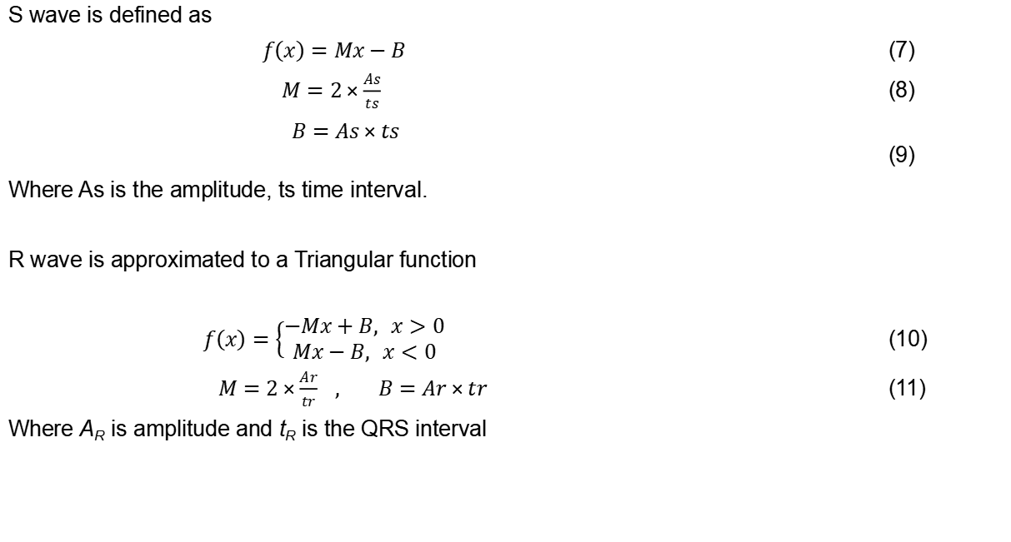
Mathematical Model
S wave is defined as
$f\left(x\right)=Mx−B$ (7)
$M=2×\frac{As}{ts}$ (8)
$B=As×ts$ (9)
Where As is the amplitude, ts time interval.
R wave is approximated to a Triangular function
$f\left(x\right)=\left\{\begin{aligned}−Mx+B, &x>0 \\ Mx−B, &x<0\end{aligned}\right.$ (10)
$M=2×\frac{Ar}{tr}$ $, B=Ar×tr$ (11)
Where A_{R} is amplitude and t_{R} is the QRS interval

Slide 6
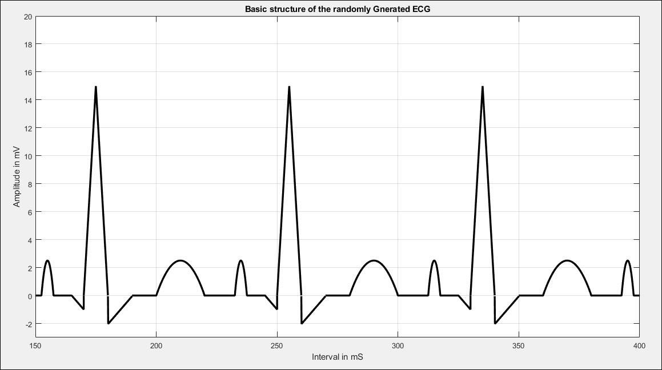

Fourier Series Approximation
$Ao=\frac{1}{L}\int_{−L}^{L}{f\left(x\right) dx}$ (12)
$An=\frac{1}{L}\int_{−L}^{L}{f\left(x\right)\cos\left(\frac{nπx}{L}\right)dx}$ (13)
$$Bn=\frac{1}{L}\int_{−L}^{L}{f\left(x\right)\sin\left(\frac{nπx}{L}\right)dx} (14)$$
$$f\left(x=i\right)=\frac{Ao}{2}+ \sum_{n=0}^{n}{An×}\cos\left(\frac{nπx}{L}\right) + \sum_{n=0}^{n}{Bn×\sin\left(\frac{nπx}{L}\right)}$$
(15)
$i=p,q,r,s,t waves$
L is Period of a function.
After Fourier series approximation of the PQRST wave are combined together

Slide 7
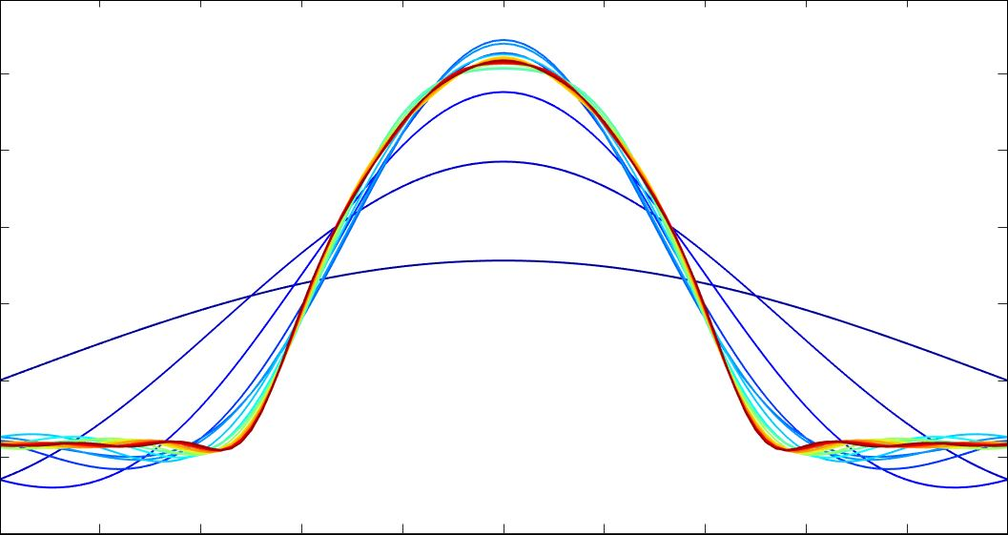
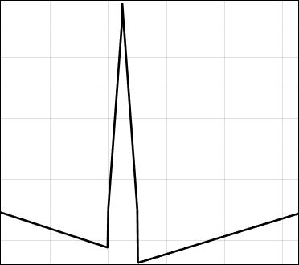
Mathematical Model
P and T wave approximated to a parabolic function
The QRS complex - Q R snd S wave
fig.1. P and T waves
fig.2. QRS complex

Slide 8
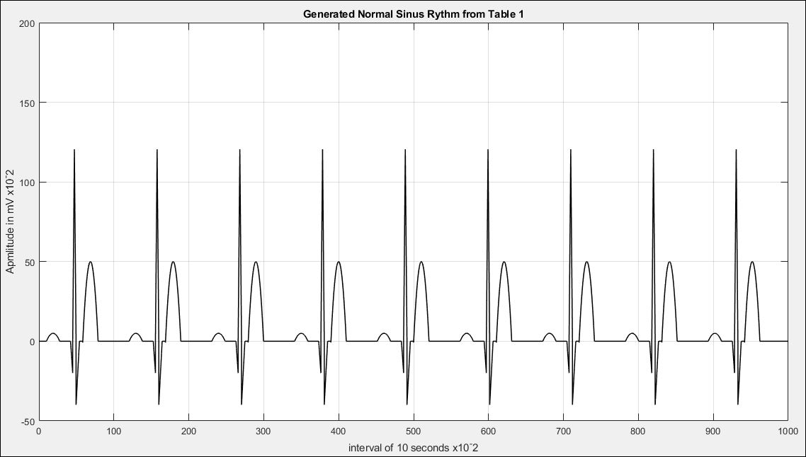
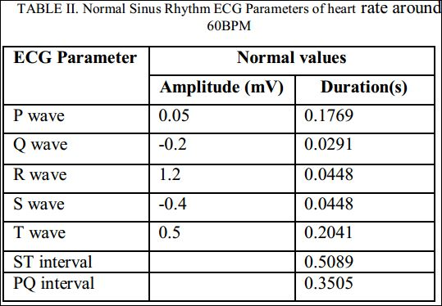
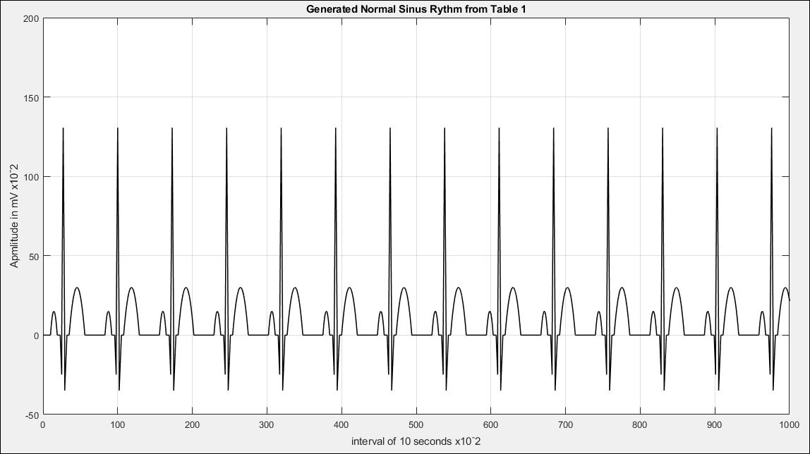
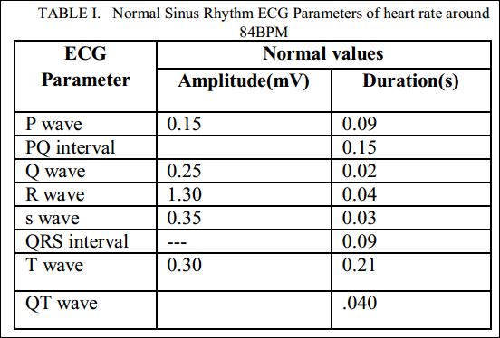
Test cases and Results

Slide 9
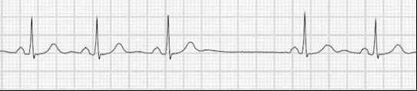
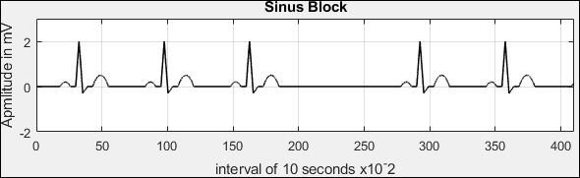
Test cases and Results
Sinus Block
Real ECG Strip of SInus Block
Generated ECG, Sinus Block

Slide 10
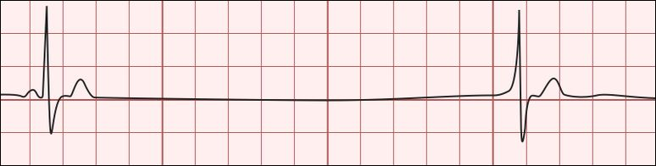
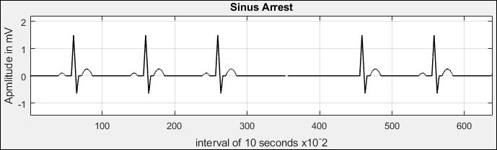
2. Sinus Arrest
Real ECG strip of Sinus Arrest
Generated Sinus Arrest considering the parameters

Slide 11
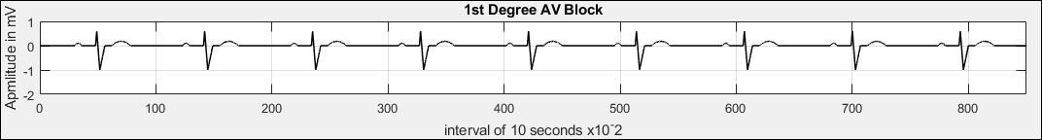
3. 1st Degree AV Block
Real ECG Strip of 1st degree AV Block
Generated 1st deg AV Block

Slide 12
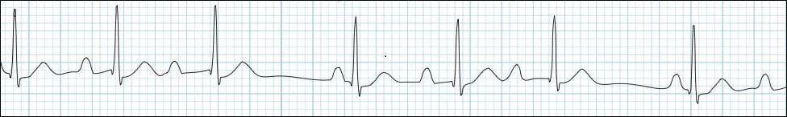
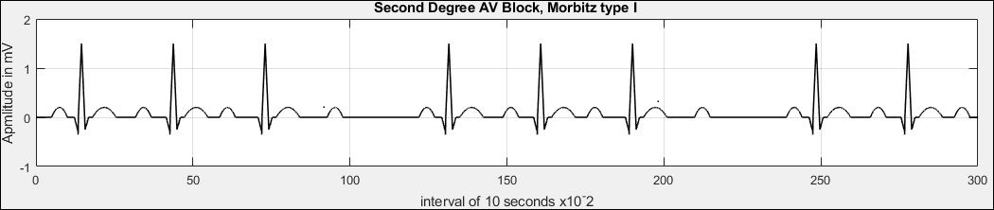
4. 2nd degree AV Block type 1
Real ECG Strip of 2nd deg AV Block Type I
Generated 2nd deg AV Block type I

Slide 13
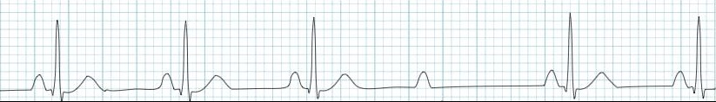
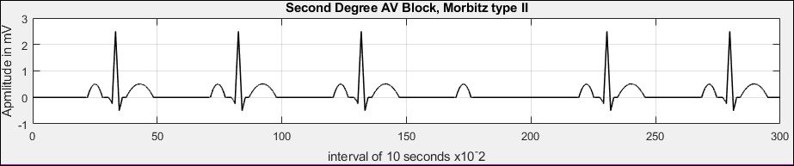
5. 2nd Degree AV Block type 2
Real ECG Strip of 2nd deg AV Block Type II
Generated 2nd deg AV Block Type II

Slide 14
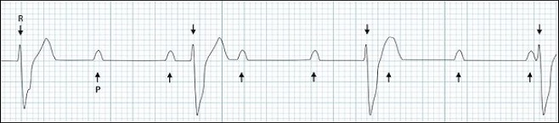
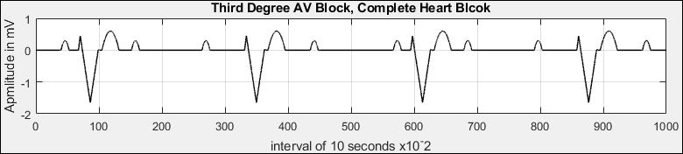
6. 3rd Degree AV Block
Real ECG Strip of 3rd deg AV Block
Generated 3rd deg AV Block

Slide 15
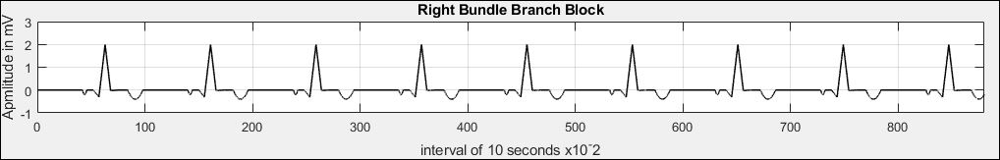
7. Right Bundle Branch Block
Real ECG Right Bundle Branch Block
Generated Right Bundle Branch Block

Slide 16
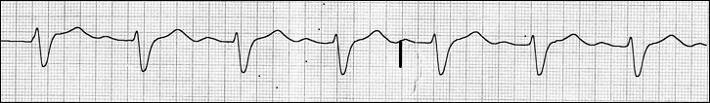
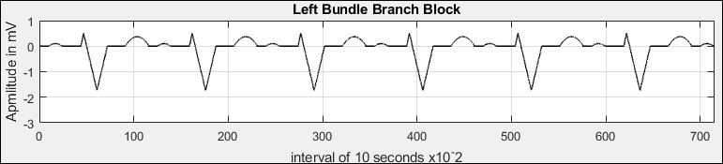
8. Left Bundle Branch Block
Real ECG Strip of Left Bundle Branch Block
Generated Left Bundle Branch Block

Slide 17
References
1. Nayak V. (2021) Generation of ECG for Heart Block Cases. In: Kalya S., Kulkarni M., Shivaprakasha K.S. (eds) Advances in VLSI, Signal Processing, Power Electronics, IoT, Communication and Embedded Systems. Lecture Notes in Electrical Engineering, vol 752. Springer, Singapore.
doi.org/10.1007/978-981-16-0443-0_17
2. P. E. McSharry, G. D. Clifford, L. Tarassenko and L. A. Smith, "A dynamical model for generating synthetic electrocardiogram signals," in IEEE Transactions on Biomedical Engineering, vol. 50, no. 3, pp. 289-294, March 2003,
doi: 10.1109/TBME.2003.808805.
3. S. L. M. Abad, N. J. Dabanloo and M. Mohagheghi, "Different Approaches for Linear and Non-linear ECG Generation," 2008 International Conference on BioMedical Engineering and Informatics, 2008, pp. 415-419,
doi: 10.1109/BMEI.2008.168.
4. F. Ye, F. Zhu, Y. Fu and B. Shen, "ECG Generation With Sequence Generative Adversarial Nets Optimized by Policy Gradient," in IEEE Access, vol. 7, pp. 159369-159378, 2019,
doi: 10.1109/ACCESS.2019.2950383.
5. J. Kubíˇcek, M. Penhaker, R. Kahankova, Design of a synthetic ECG signal based on the
Fourier series, in Proceedings of the 2014 International Conference on Advances in Computing,
Communications and Informatics, ICACCI (2014), pp. 1881–1885.
doi.org/10.1109/icacci.2014.6968312

Slide 18
Thank You.
‘’Every Beat Counts”

